Slide 1





VAP Team
Emergency
Wave

Slide 2
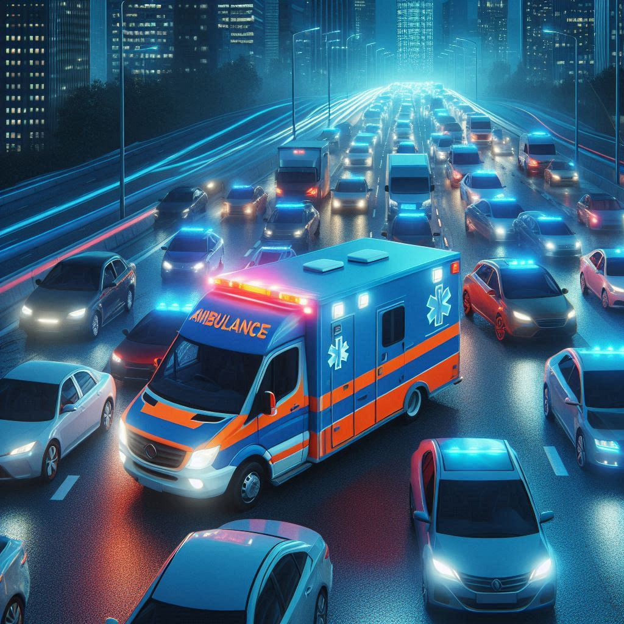

Overview
Problem Statement
01
Solution
02
Business Idea
03
Future enhancement
04
Our Team
05

Slide 3
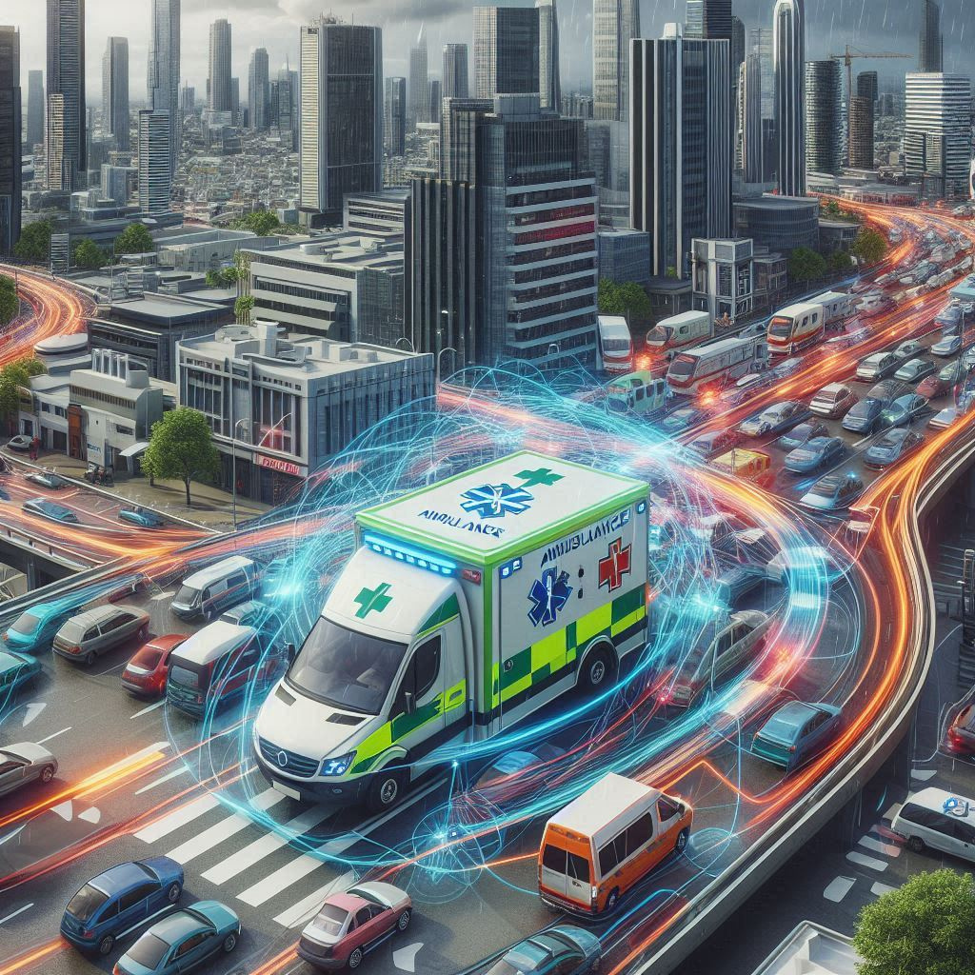
Problem synopsis
In urban areas, high traffic congestion significantly delays the response times of emergency vehicles, particularly ambulances. These delays can be critical, affecting the survival and recovery chances of patients in need of urgent medical care. Traditional traffic management systems are often inefficient in dynamically providing a clear path for ambulances, resulting in longer travel times and potential loss of life.

Slide 4
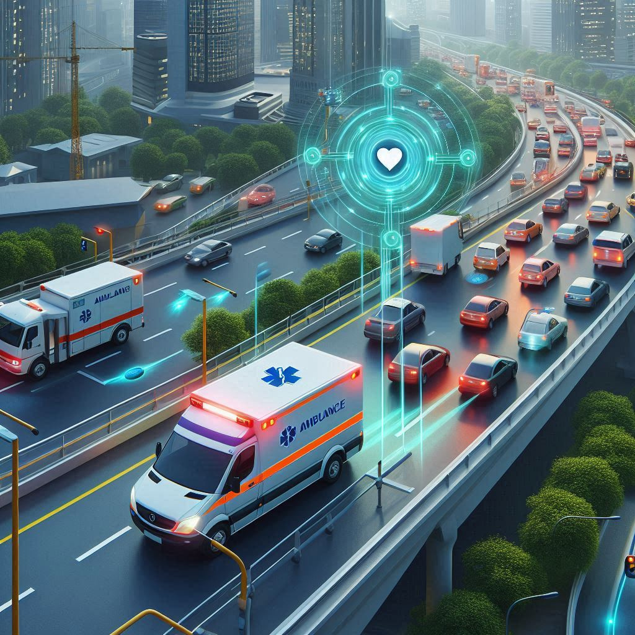


A web-based real-time ambulance routing and alert system.
Our Solution
Integration of GPS, real-time traffic data, and communication protocols.
Sends alerts to vehicles, traffic signals, and authorities to clear the path for the ambulance.

Slide 5
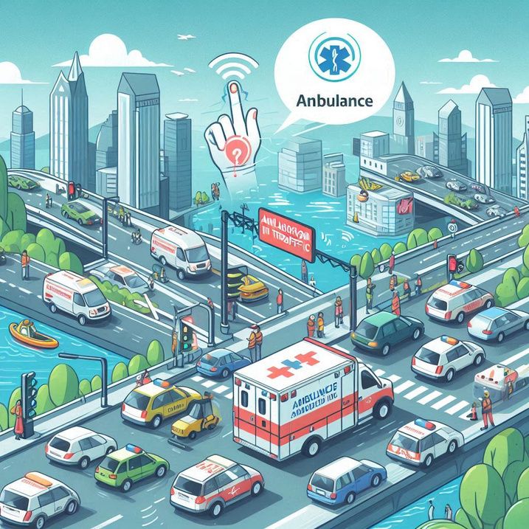
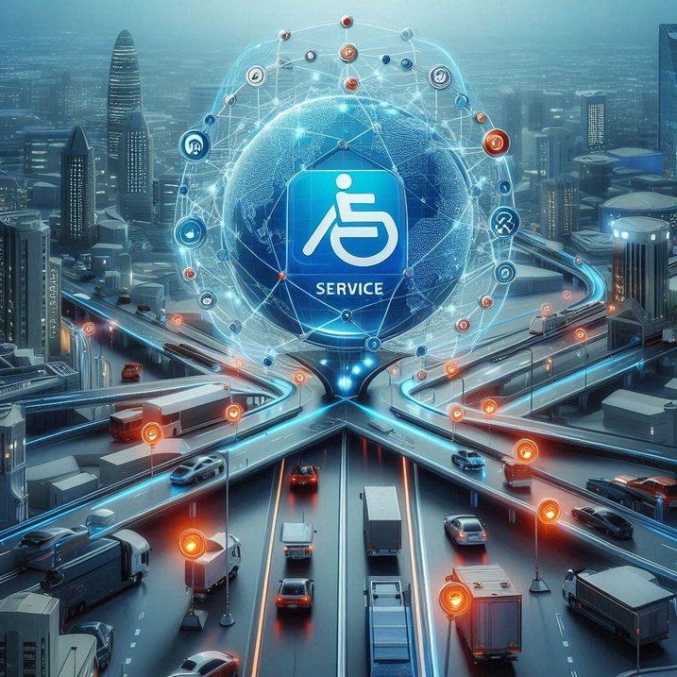

Business Idea
Urban Traffic and Smart City Solutions
Intelligent Transport and Logistics Coordination
Healthcare and Emergency Response Optimization
Contracts with city governments for implementation as part of smart city initiatives, funded by public budgets or grants.
Service agreements with traffic authorities to integrate the system with city-wide traffic control mechanisms.
Subscription-based service where healthcare providers pay a monthly or annual fee for access to the system.

Slide 6
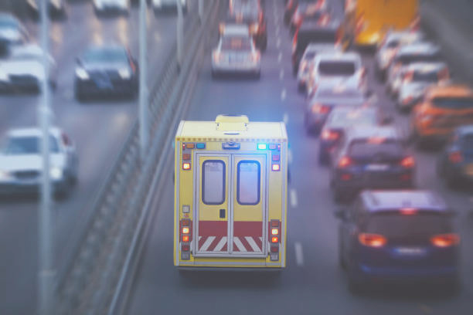


Future Enhancements
Integration with Other Emergency Services:
Expand the system to include fire trucks and police vehicles.
AI and Machine Learning: Implement
AI algorithms to predict traffic patterns and optimize routes.
Mobile App Development:
Develop a mobile app for ambulance drivers and traffic officials.
Global Positioning Enhancements:
Integrate advanced GPS for precise location tracking.

Slide 7




Our Team
Ananya Udupa
Pratham P Shetty
Vrushali A Poojary
Dhanyashree

Slide 8
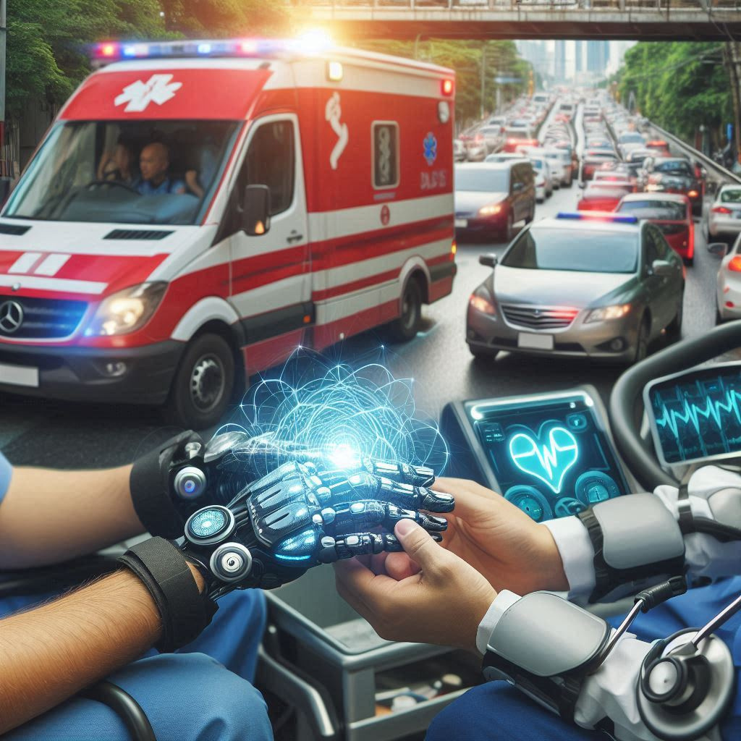
VAP Team
THANK YOU!

